Slide 1
The Field of Data Science
Statistical Modeling
Shahriar’s Analytical Academy

Slide 2
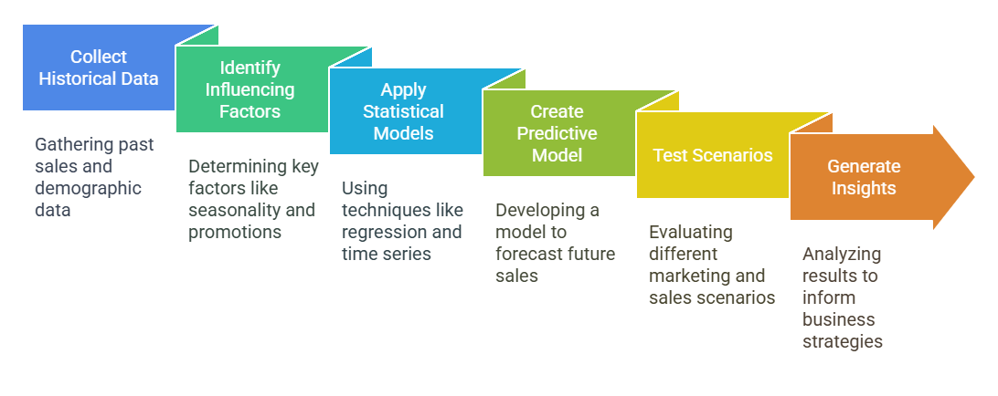
Definition and Example
Statistical modeling is the process of using mathematical models to represent and analyze real-world phenomena based on statistical data. It allows the prediction of future events or understanding of relationships between variables. Through statistical modeling, businesses can uncover hidden patterns, test hypotheses, and make informed decisions based on historical data.
Notes:
Statistical modeling is the process of using mathematical models to represent and analyze real-world phenomena based on statistical data. It allows the prediction of future events or understanding of relationships between variables. Through statistical modeling, businesses can uncover hidden patterns, test hypotheses, and make informed decisions based on historical data. These models are crucial for businesses looking to anticipate future trends and behaviors, optimizing their operations and resources accordingly.
Example Scenario: Imagine a retail company that wants to predict its sales for the next quarter. The company has collected historical data on product sales, customer demographics, and external factors such as economic conditions, seasonality, and marketing promotions. By applying statistical modeling techniques such as linear regression or time series analysis, the company can quantify how each factor affects sales. For instance, they may find that sales are highly influenced by the time of year (seasonality) and that marketing promotions drive a significant increase in sales during certain periods.
Through statistical modeling, the company can create a predictive model that forecasts sales for the upcoming quarter. The model can account for variables such as customer age, income, and purchasing frequency, helping the business to plan for inventory needs, optimize staffing, and tailor marketing strategies. Additionally, the model can test different scenarios, such as the impact of increasing marketing spend, to provide insights into how these actions might influence future sales. This allows the company to make data-driven decisions and prepare for various possible outcomes in a more informed manner.

Slide 3
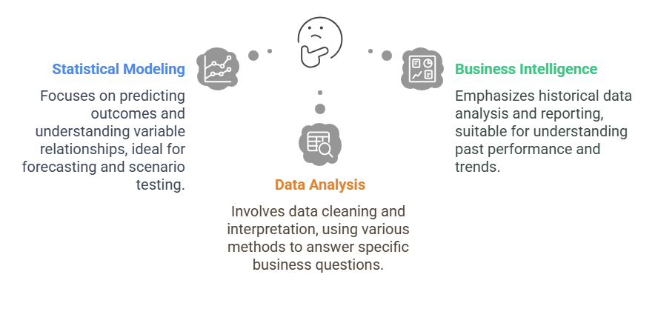
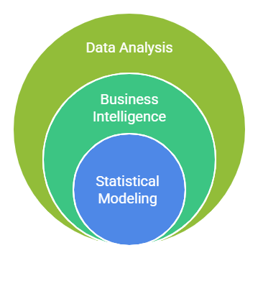
Data Analysis v/s BI v/s Statistical Modeling
Notes:
Statistical Modeling: Statistical modeling focuses on using mathematical methods to represent relationships between variables. It often involves techniques like hypothesis testing, regression analysis, and predictive modeling. These methods are used to uncover deeper insights from data and to make predictions about future outcomes. For example, a company might use statistical modeling to predict customer behavior based on past purchases. The goal of statistical modeling is to understand how different factors are related and to make data-driven forecasts.
Business Intelligence (BI): Business Intelligence (BI) is primarily concerned with aggregating data, creating reports, and developing dashboards to present business metrics and insights. It is mainly focused on providing insights into past performance and trends, which helps businesses make informed decisions. BI tools allow businesses to analyze historical data, such as sales figures, customer demographics, and market performance. For example, BI might reveal that a particular product sells best during specific months of the year. The main aim of BI is to assist in making data-driven decisions based on what has already happened.
Data Analysis: Data analysis is a broad term that involves several processes, such as cleaning, interpreting, and analyzing data to uncover meaningful insights. It can include both statistical techniques (like regression analysis) and machine learning methods (like classification or clustering). Data analysis is focused on answering specific business questions by using various approaches, including descriptive, inferential, and predictive methods. For example, a company might use data analysis to understand customer satisfaction levels or identify factors contributing to sales performance. Data analysis is essential for drawing conclusions from data, whether it's about past trends, relationships between variables, or making future predictions.
In summary, statistical modeling is focused on mathematical relationships and predictions, BI focuses on reporting historical data and trends, while data analysis encompasses a broad range of methods for cleaning, interpreting, and answering specific questions with data.

Slide 4
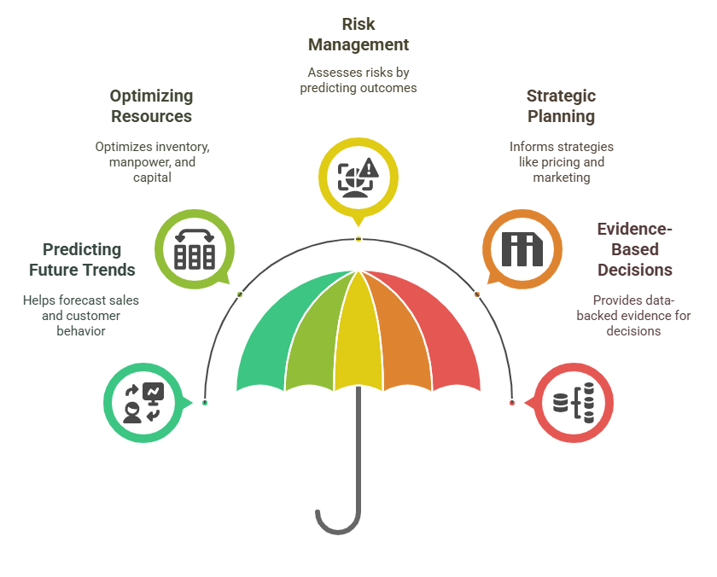
Importance of
Statistical Modeling
Notes:
Predicting Future Trends: One of the key benefits of statistical modeling in business is its ability to predict future trends. For example, statistical models can be used to forecast sales, customer behavior, or market demand. This foresight helps businesses prepare for future events and plan accordingly. By understanding potential outcomes, businesses can make informed decisions about inventory, staffing, and marketing strategies, helping them stay ahead of the competition.
Optimizing Resources: Statistical modeling also plays a crucial role in optimizing business resources. By analyzing the relationship between different inputs (like raw materials, labor, or capital) and outputs (such as finished products or services), businesses can allocate resources more efficiently. For instance, a statistical model might show that increasing manpower during certain hours leads to higher sales, allowing the business to adjust staffing levels to maximize productivity while minimizing costs.
Risk Management: Another important application of statistical modeling is in risk management. By using statistical models, businesses can assess the risks associated with different decisions by predicting possible outcomes and evaluating their probabilities. For example, a company might use statistical modeling to predict the likelihood of a product failing in the market or a supply chain disruption. Understanding these risks allows businesses to take proactive measures to minimize potential losses or avoid costly mistakes.
Strategic Planning: Statistical models provide valuable insights that help businesses with strategic planning. For example, businesses can use statistical analysis to determine the optimal pricing strategy, identify the most effective marketing tactics, or analyze customer preferences. These insights allow businesses to make data-driven decisions when creating long-term plans, ensuring they choose the most effective strategies to achieve their goals.
Evidence-Based Decisions: Statistical modeling provides data-backed evidence that supports decision-making, reducing uncertainty and bias. Instead of relying on intuition or guesswork, businesses can use statistical models to make decisions based on real data. This evidence-based approach helps businesses gain confidence in their decisions and improves the overall accuracy of their strategies. For instance, using statistical models to analyze past sales data can help determine the best pricing strategies for future products.

Slide 5
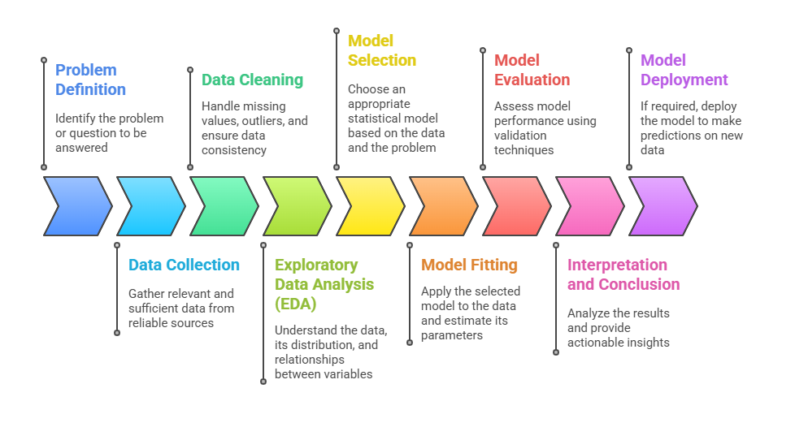
Steps in Statistical Modeling
Notes:
Problem Definition: The first step in statistical modeling is to clearly identify the problem or question you want to answer. This could be anything from forecasting sales to understanding customer behavior. Defining the problem sets the direction for the entire modeling process, ensuring that the right data is collected and the correct modeling techniques are applied.
Data Collection: Once the problem is defined, the next step is to gather relevant data from reliable sources. The data should be sufficient to answer the question at hand. For example, if you're modeling sales, you'll need historical sales data, customer demographics, and other related information. The quality of your data is crucial for the success of the model.
Data Cleaning: Data cleaning is an essential step in the process. It involves handling missing values, removing outliers, and ensuring data consistency. Incomplete or incorrect data can distort the model and lead to inaccurate results. For example, if a sales record is missing, it may need to be filled in or removed, depending on the situation.
Exploratory Data Analysis (EDA): Exploratory Data Analysis (EDA) helps you understand the data before applying any statistical models. This step involves visualizing the data, checking its distribution, and exploring relationships between different variables. For example, a scatter plot might reveal whether there's a linear relationship between advertising spend and sales. EDA helps to identify patterns and insights that guide the modeling process.
Model Selection: After exploring the data, the next step is to choose the appropriate statistical model based on the data and the problem you're trying to solve. For example, if you're analyzing time-based data, a time series model might be appropriate. If you're looking at relationships between variables, a linear regression model might be suitable. The choice of model depends on the nature of the data and the problem you're trying to answer.
Model Fitting: Model fitting involves applying the selected model to the data and estimating its parameters. This is the process where the model "learns" from the data. For example, in linear regression, the model will find the line that best fits the data by estimating the slope and intercept that minimize the error between predicted and actual values.
Model Evaluation: After fitting the model, it's important to evaluate its performance to ensure it accurately predicts or explains the data. This is done using validation techniques like Root Mean Squared Error (RMSE), Akaike Information Criterion (AIC), or cross-validation. These methods help assess the model's accuracy and whether it generalizes well to new data.
Interpretation and Conclusion: After evaluating the model, you need to analyze the results and extract actionable insights. For example, if you're using a linear regression model, you would interpret the coefficients to understand how each variable influences the outcome. This step helps translate the technical results into business decisions or recommendations.
Model Deployment: If the model performs well and provides valuable insights, the final step is deployment. In this step, the model is used to make predictions on new data, allowing businesses to take action based on the model's predictions. For example, a forecasting model could be deployed to predict sales in the coming months, and the company could adjust its strategies accordingly.

Slide 6
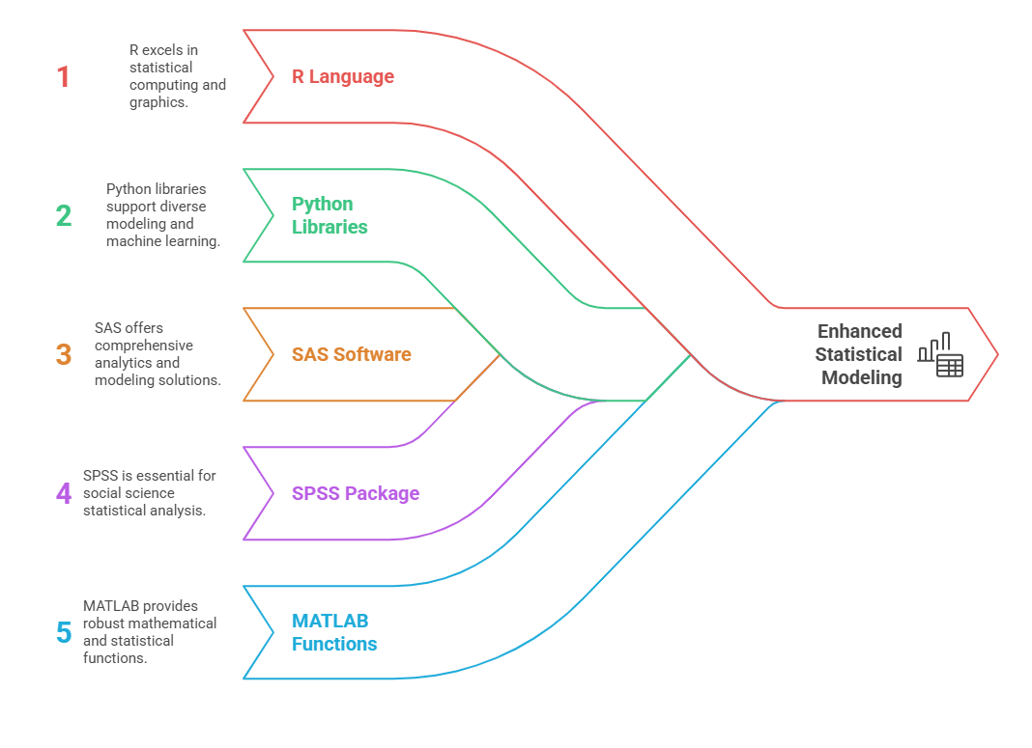
Tools of
Statistical Modeling
Notes:
R: R is a programming language and software environment primarily designed for statistical computing and graphics. It is widely used due to its advanced statistical modeling capabilities, offering a vast array of statistical functions and libraries. R is especially favored in academia and research for tasks such as hypothesis testing, regression analysis, and data visualization. It’s highly flexible and customizable, making it suitable for a variety of complex data analysis tasks.
Python: Python is another powerful tool for statistical modeling, supported by a range of libraries like pandas, NumPy, statsmodels, and scikit-learn. These libraries make Python an excellent choice for both statistical modeling and machine learning tasks. Python’s ease of use, combined with its extensive support for data manipulation and analysis, makes it popular among data scientists and analysts for a wide variety of applications.
SAS: SAS (Statistical Analysis System) is a comprehensive software suite designed for advanced analytics, business intelligence, and statistical modeling. It’s widely used in industries like healthcare, finance, and government for performing high-level statistical analysis and data management. SAS provides a robust set of tools for data analysis, predictive modeling, and reporting, making it a go-to tool for professionals in large organizations.
SPSS: SPSS (Statistical Package for the Social Sciences) is a widely-used software package primarily aimed at statistical analysis in social sciences. It is user-friendly, with a point-and-click interface that allows researchers and analysts to perform statistical tests, data manipulation, and descriptive statistics without needing to write code. SPSS is commonly used for surveys, market research, and psychological studies.
MATLAB: MATLAB is known for its powerful mathematical and statistical functions, often used in engineering, physics, and data science. It is particularly strong in numerical computing and matrix-based operations, which makes it ideal for tasks like optimization, machine learning, and statistical analysis. While MATLAB is widely used in academia and industries like aerospace and automotive, it’s also becoming more popular in the data science community for its efficient handling of large datasets and advanced algorithms.

Slide 7
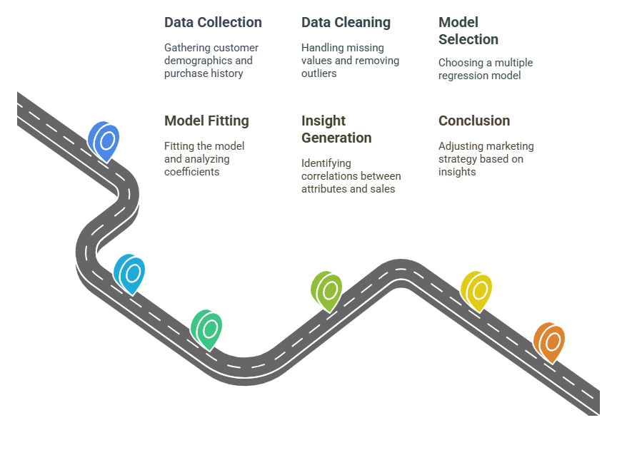
How to find insight from scenario example
Scenario: A retail company wants to understand how customer age, income, and purchase
frequency affect product sales.
Notes:
Scenario: A retail company wants to understand how customer age, income, and purchase frequency affect product sales.
Step 1 – Data Collection: The first step is to collect relevant data. In this case, the company gathers customer demographics such as age and income, along with their purchase history (e.g., how often they buy products, and how much they spend). This data provides the foundation for analyzing the factors influencing product sales.
Step 2 – Data Cleaning: Next, the data must be cleaned to ensure accuracy. This involves handling missing values (e.g., if some customers didn’t provide income information), removing outliers in purchase frequency (e.g., if one customer made an unusually high number of purchases compared to others), and ensuring data consistency (e.g., ensuring all income data is in the same currency). Clean data is essential for reliable results.
Step 3 – Model Selection: The appropriate model for this scenario is multiple regression, which is used to assess the relationship between several independent variables (age, income, purchase frequency) and a dependent variable (sales). Multiple regression allows us to understand how each factor influences sales while considering the effects of other factors simultaneously.
Step 4 – Model Fitting: The next step is to apply the multiple regression model to the data. This involves fitting the model to the data and estimating the coefficients for each variable (age, income, and purchase frequency). These coefficients tell us how much each variable contributes to sales. For instance, a higher coefficient for income would indicate that income has a stronger effect on sales than other variables.
Step 5 – Insight Generation: After analyzing the regression model, you can generate insights. In this case, the model might show that both age and income are positively correlated with product sales, meaning that as age and income increase, sales also increase. However, income could have a stronger effect than age. This suggests that high-income customers are likely to spend more on products. The company could use this insight to adjust its targeting strategy.
Step 6 – Conclusion: Based on the findings from the model, the company can adjust its marketing strategy. For example, if income has a stronger influence on sales, the business might decide to target high-income customers for more expensive products, such as premium items or luxury goods. This data-driven strategy would help the company optimize its sales approach and increase profitability by focusing on the most promising customer segments.

Slide 8
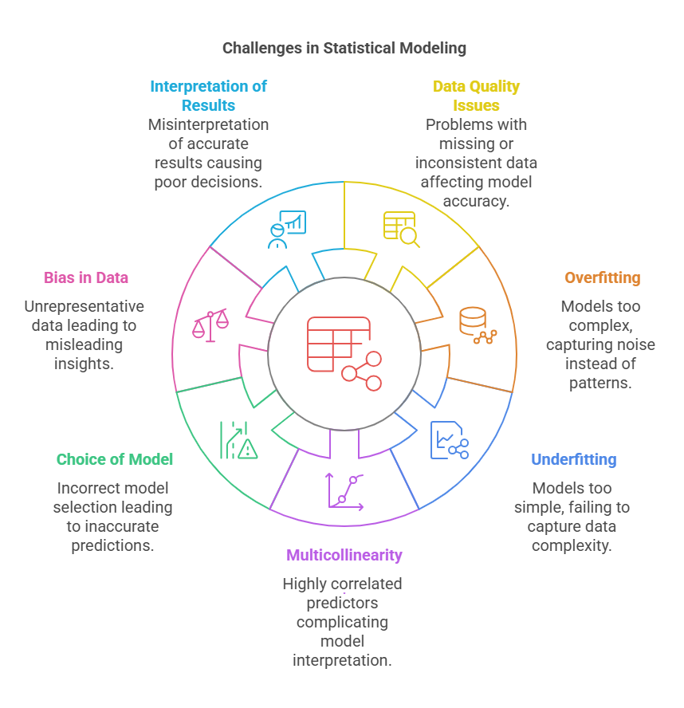
Challenges in
Statistical Modeling
Notes:
Data Quality Issues: One of the primary challenges in statistical modeling is data quality. Issues such as missing values, inconsistencies, and noisy data (irrelevant or random information) can negatively impact model performance. For example, missing income data or inconsistent customer information can cause the model to provide inaccurate predictions. Ensuring clean, reliable, and consistent data is crucial for building effective models.
Overfitting: Overfitting occurs when a model is too complex and captures not just the true patterns in the data, but also the random noise or fluctuations. This makes the model highly specific to the training data, which might result in poor performance on new, unseen data. A classic example of overfitting is when a regression model fits every tiny detail of the data perfectly but fails to generalize to new data points.
Underfitting: Underfitting happens when a model is too simple to capture the underlying complexity of the data. This leads to poor performance because the model cannot learn the important patterns. For example, using a linear regression model on highly non-linear data might lead to underfitting, where the model’s predictions don’t match the true behavior of the data.
Multicollinearity: Multicollinearity occurs when predictor variables in the model are highly correlated with each other. This can make it difficult to determine the individual effect of each predictor on the outcome variable. For example, in a regression model, if both income and education level are highly correlated, it might be challenging to determine which one has a stronger effect on product sales. Multicollinearity can lead to unstable estimates and unreliable model interpretations.
Choice of Model: Selecting the wrong model for the data is another challenge in statistical modeling. If the model doesn’t match the nature of the data, it can lead to inaccurate predictions and misleading insights. For example, using a linear model when the relationship between variables is non-linear can lead to poor results. It's important to carefully choose a model that aligns with the characteristics of the data.
Bias in Data: Bias in data is a significant concern. If the data collected is biased or unrepresentative of the population being studied, it can lead to misleading insights. For example, if a survey about customer preferences is conducted only with high-income individuals, the results may not reflect the preferences of the entire customer base. Bias in data can skew results and undermine the validity of the conclusions drawn from the analysis.
Interpretation of Results: Even with accurate models, incorrect interpretation of statistical results can lead to poor decision-making. It's important to understand the limitations and context of the model’s findings. For example, assuming causality from a correlation or overlooking the impact of external factors can lead to wrong conclusions. Proper interpretation ensures that the insights derived from statistical models are used appropriately in decision-making.

Slide 9
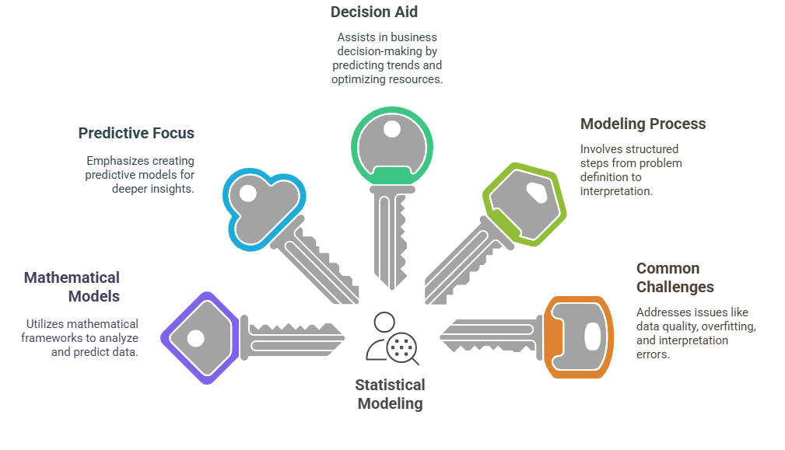
5 Key Learning Points of this Lesson
Notes:
Here are the 5 key learning points from the lesson:
Statistical modeling involves creating mathematical representations to analyze data and make predictions about real-world events or phenomena. By applying statistical techniques to data, businesses can forecast future trends and behaviors, helping to make informed decisions.
While Business Intelligence (BI) focuses on reporting past performance and trends, and data analysis covers a broad range of techniques for exploring data, statistical modeling specifically focuses on creating predictive models. It goes deeper by uncovering insights that help explain the relationships between variables and predict future outcomes.
Statistical modeling plays a critical role in business decision-making by predicting trends, optimizing resources, and assessing risks. It enables companies to forecast future scenarios, like sales or customer behavior, and helps businesses make strategic decisions based on data-driven predictions.
The process of statistical modeling includes key steps such as problem definition, data collection, model selection, fitting the model to the data, evaluating the model's performance, interpreting the results, and drawing conclusions. Each step is crucial to ensure the model is both accurate and useful in making predictions.
Statistical modeling faces several challenges, such as data quality issues (e.g., missing or inconsistent data), overfitting (when the model becomes too complex), underfitting (when the model is too simple), multicollinearity (when predictor variables are highly correlated), and errors in interpretation. Overcoming these challenges is essential for building reliable and effective models.

Slide 10
Thank You!
Shahriar’s Analytical Academy

